Slide 1

WAY TO ENTERPRISE
Projects
VTI ACADEMY
Author: duy.nguyenngoc1@vti.com.vn
April 2021

Slide 2
Agenda
Planning
SRS
Design
Coding
Testing
Copyright © VTI Academy All Rights Reserved

Slide 3
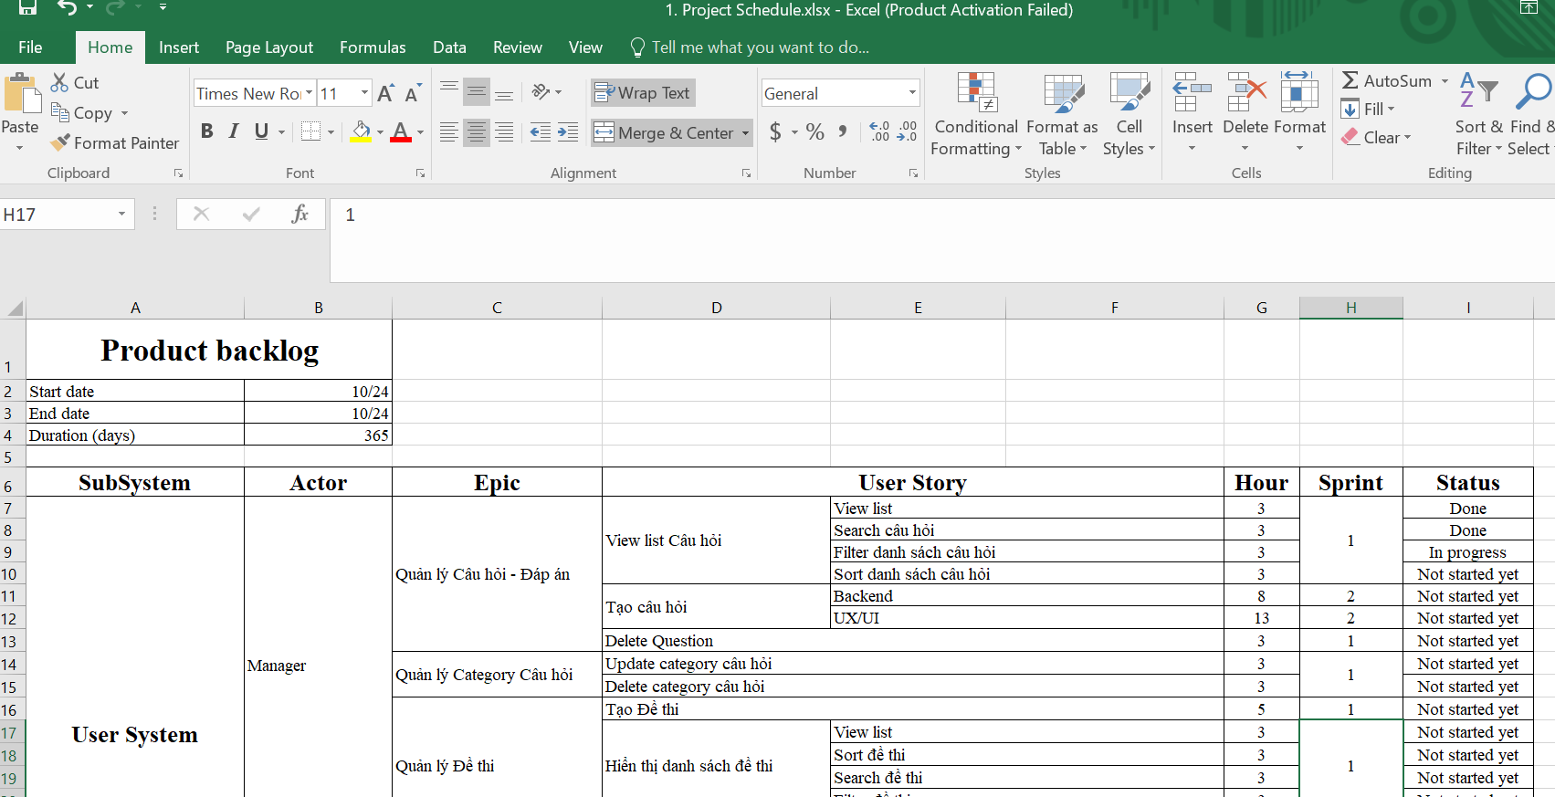
Planning

Slide 4
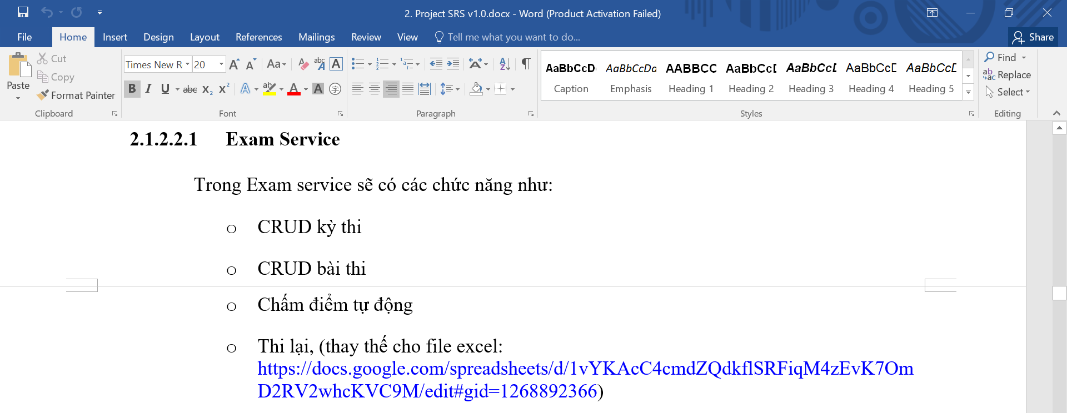
SRS

Slide 5
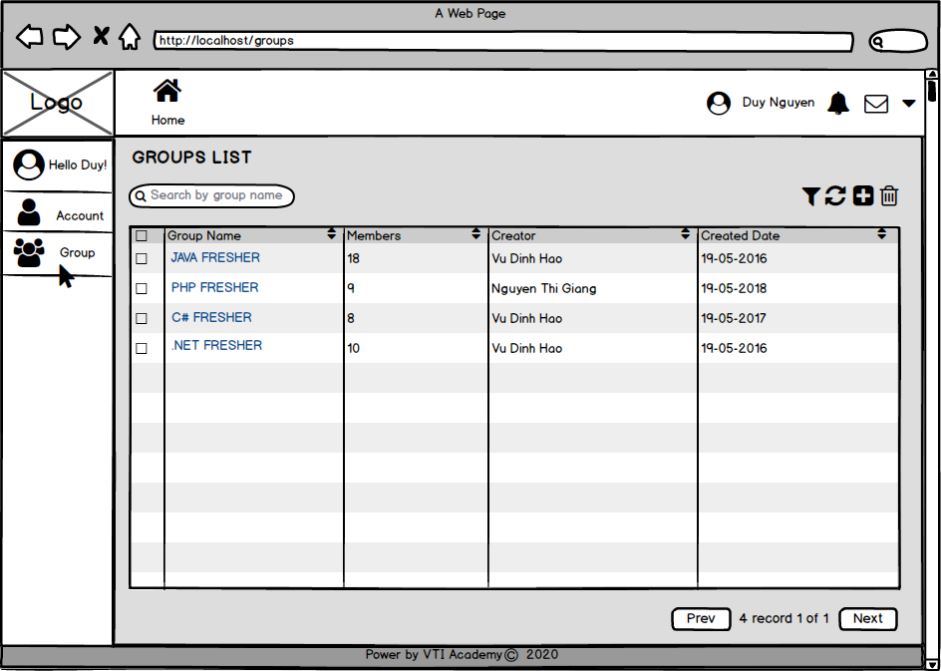
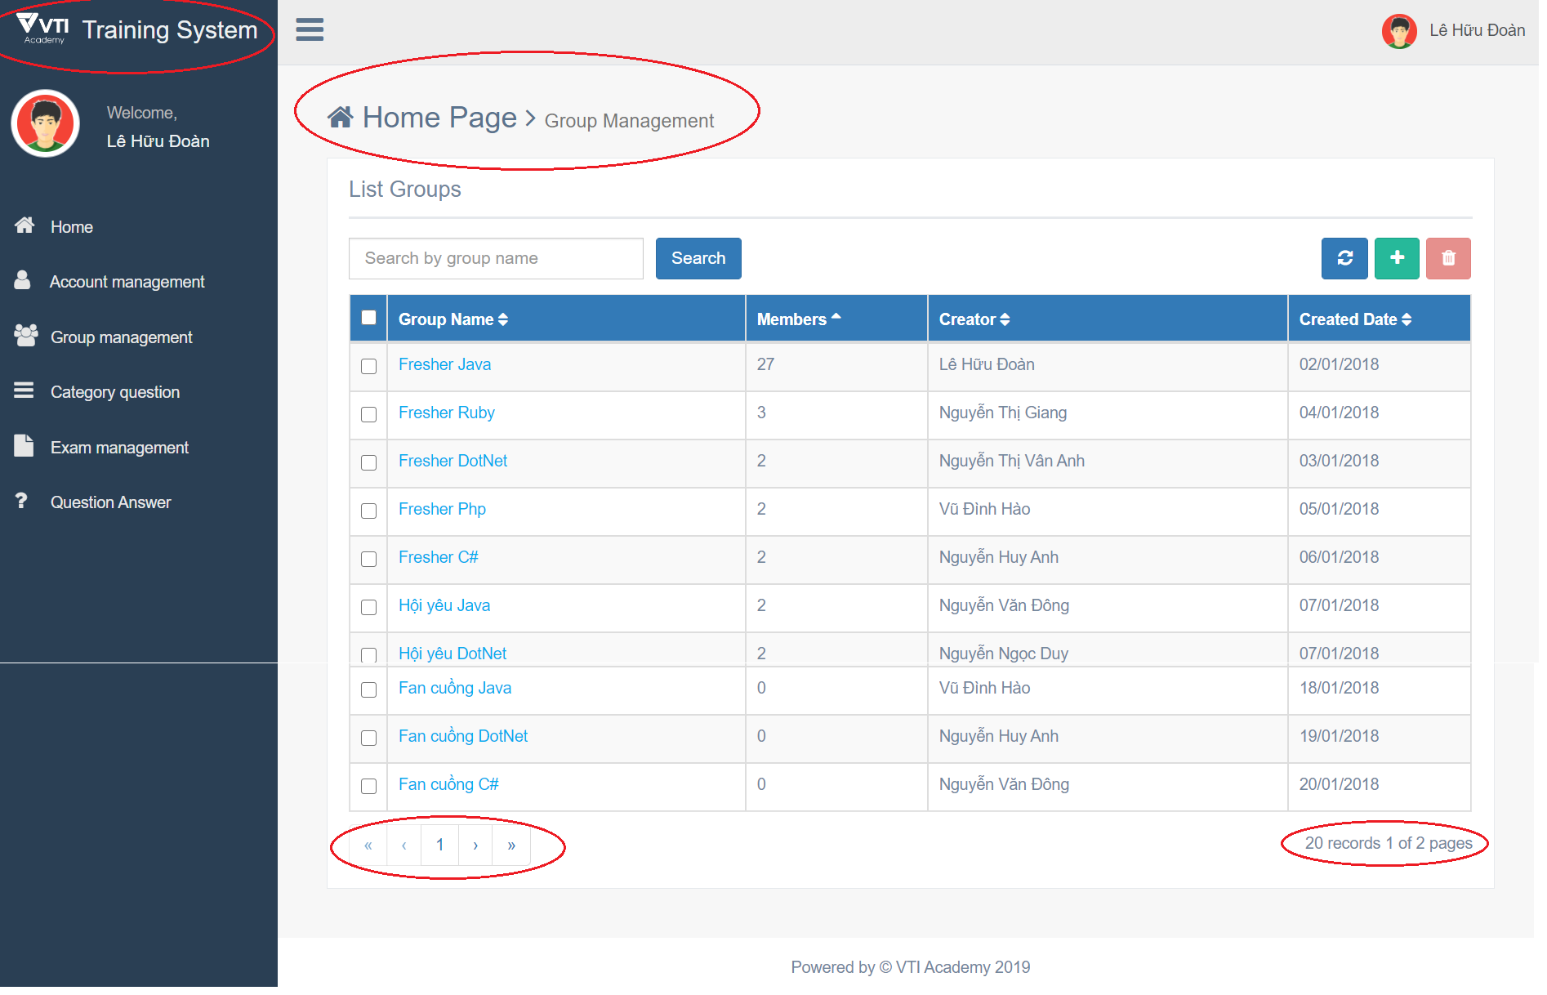
Design
Tools: Balsamiq
Mockup
Screen
View Group List

Slide 6

Coding
Database
Backend
Front-end

Slide 7
Q & A
Copyright © VTI Academy All Rights Reserved

